Slide 1

Marketing Campaign Analysis Report
Saturation,Distributions and Probability

Slide 2

Overview
The dataset consists information about the marketing campaign for 1 whole year.
The KPIs which we will be working on are channel like organic,social,paid etc.,daily overall traffic,daily overall conversions.
This is a digital marketing campaign and our job is to provide insights and recommendations
to the marketing team based on the findings.

Slide 3

Management Requests
When did our campaigning efforts reach saturation?
Which channels are overleveraged?
What optimization recommendations can you provide?
What are the chances of having more than 8 conversions a day?

Slide 4

Methodology
Technology:
MS Excel(Formulas,Pivot Table,Charts and Graphs)
MS Powerpoint
Techniques:
Slope
Distribution
Probability

Slide 5

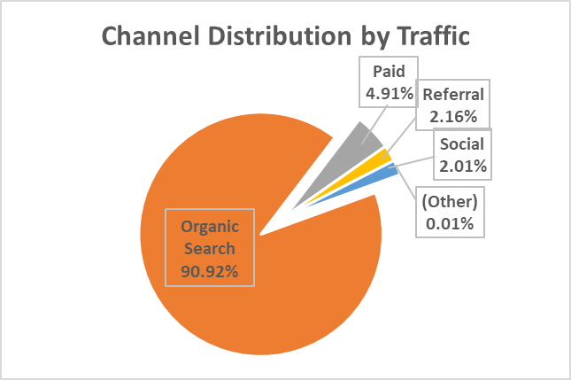
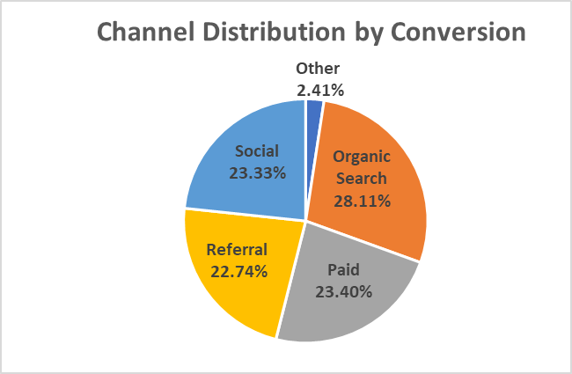
Analysis and Insights
We should diversify our acquisition channels.
Are we overleveraged by having nearly 92% of our traffic coming in organic?
The short answer is yes.
Paid marketing is 24% of traffic but only 4% of total conversions.
We need to understand users’ conversion funnel.

Slide 6
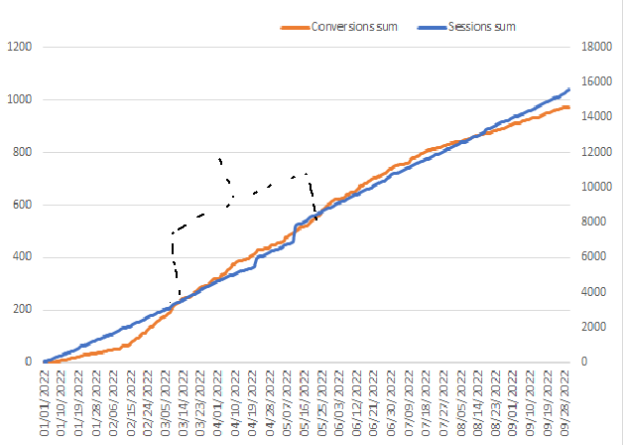
Our campaign effectiveness ended in between Late July and Early August.
Our campaign traffic took more than 3 months to find a significant audience.
We should speak to the campaign team to understand the optimizations during this period.
Our campaign peaked between April and May , with August being an inflection point.
Campaign was finding an audience
Campaign reached saturation

Slide 7
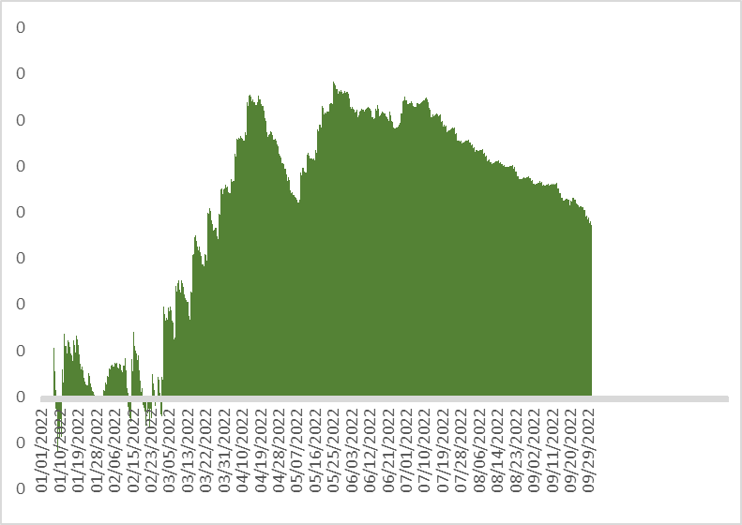
Relationship between Traffic and Conversions for all the channels.
If the learnings during the optimizations can be more readily employed , we can increase the productive period of the campaign.
Paid traffic also showed negative slope and saturation as time passed.
We can see that the slope remains negative and flat since July.
A negative or flat slope indicates the campaign saturation.

Slide 8
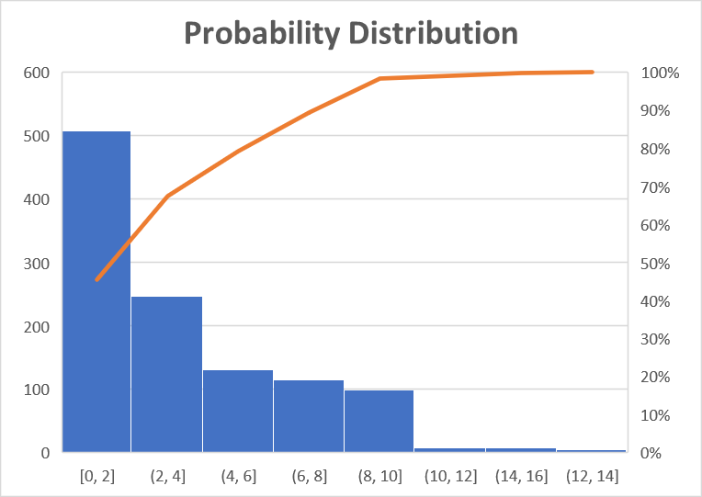
More than 8 conversions a day looks unlikely.
Daily average conversion:3.8
Max conversion:16
This indicates most of the conversions will be under 7.

Slide 9


Recommendations
Omni Channel: Evaluation of the customer journey from introduction to conversion is warranted. We may want to leverage our analytics attribution models to understand if users are being introduced and converted on single channels.
Overleveraged: We may be overleveraged on organic because if these are generic keywords, we can lose the traffic with a Google algorithm update. We should use Google Search Console to understand our keyword intent.
Optimizations: We need to have a clear understanding of what optimization were done during the first 3months of the campaign. If we can reproduce them,we can extend the productive period of the campaign.

Slide 10




THANK YOU!
Manendra Mazumder
manendramazumder@gmail.com
+91-9789947105

